Slide 1

Production Cost and Marketing Analysis of

Slide 2
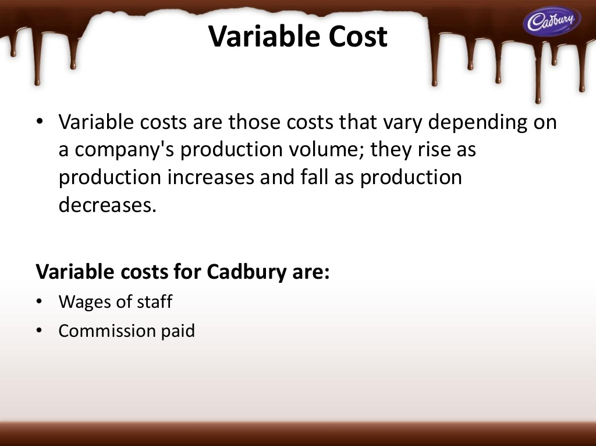
Index
Introduction pg 03
History of Cadbury pg 04
Brand Portfolio pg 05
Key brands pg 06
Production Process pg 07 to 08
Fixed cost pg 09
Variable cost pg 10
Marketing Strategy pg 11
Survival pg 12
Profit Maximization pg 13
Growth and Diversification pg 14
Brand Building pg 15
Market Share pg 16
Recent Sales pg 17
Acknowledgement pg 18

Slide 3
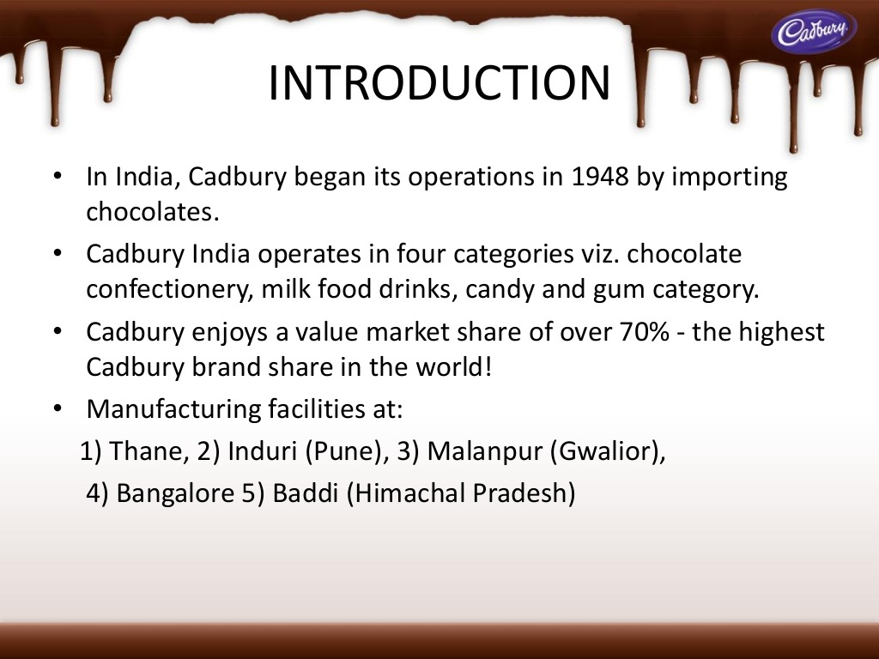

Slide 4
History Of Cadbury
Started by John Cadbury
Factory in Bourneville in 1861- largest chocolate production in U.K
1897- Manufactured 1st Milk Chocolate
1950- First overseas factory near Hobart, Tasmania.
1960’s- Larger factory with his brother selling 16 type of drinking chocolates
Today the largest confectionery company in the world; 70,000+ employees.

Slide 5
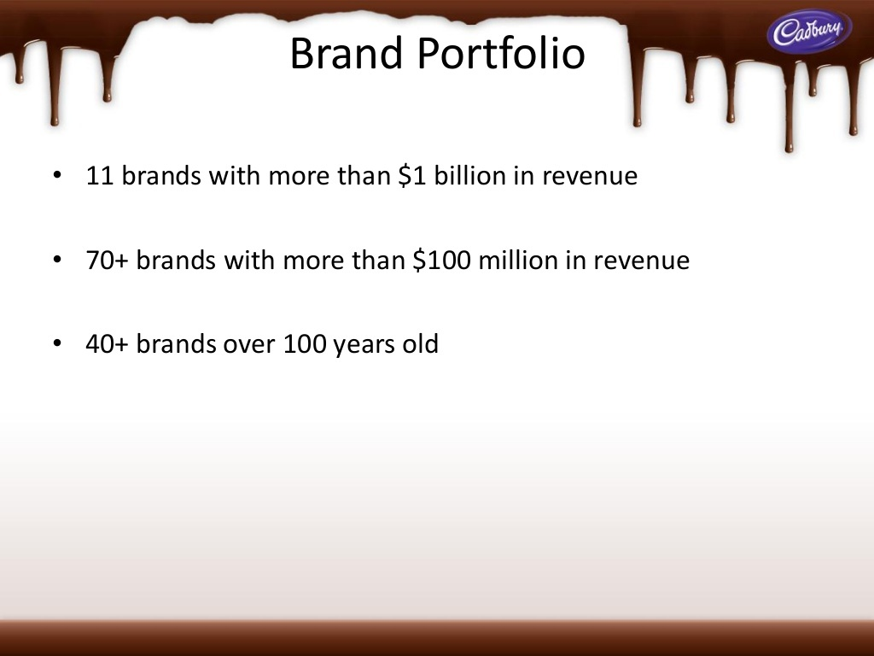

Slide 6
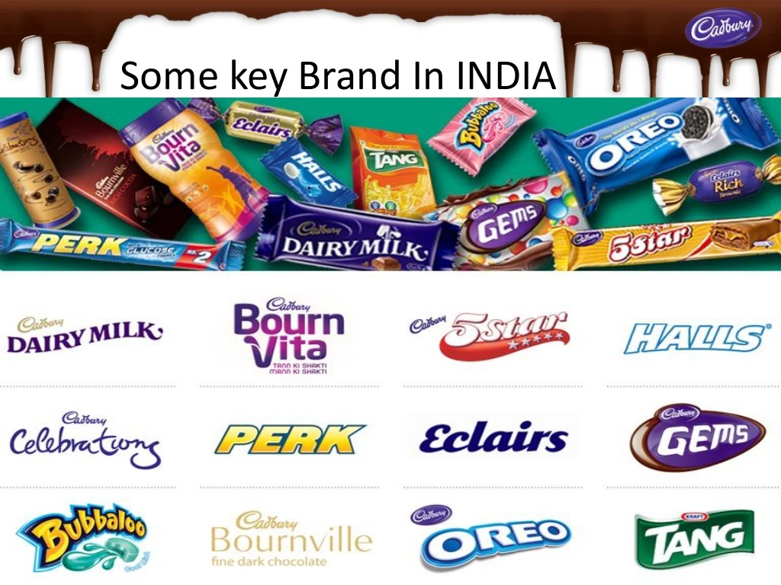

Slide 7
Production Process
Harvesting
1. Cocoa beans are imported from Indonesia, Malaysia and Ghana.
2. It takes the whole year's crop from one tree to make 450gms of Chocolate.
Processing the Cocoa Beans
1.Fermentation
2.Drying
3.Roasting
4.Grinding and Pressing

Slide 8
Production Process
Chocolate Making
1.Cocoa mass is produced which contains 53% cocoa and 47% cocoa butter.
2.Sugar is added to the condensed milk with some of the cocoa mass which is then evaporated to make milk chocolate crumb.
3.The crumb mixed with cocoa liquor and cocoa butter.
4.Tempering involves mixing and cooling the liquid chocolate under carefully controlled conditions to ensure that the fat in the chocolate crystallises in its most stable form.

Slide 9
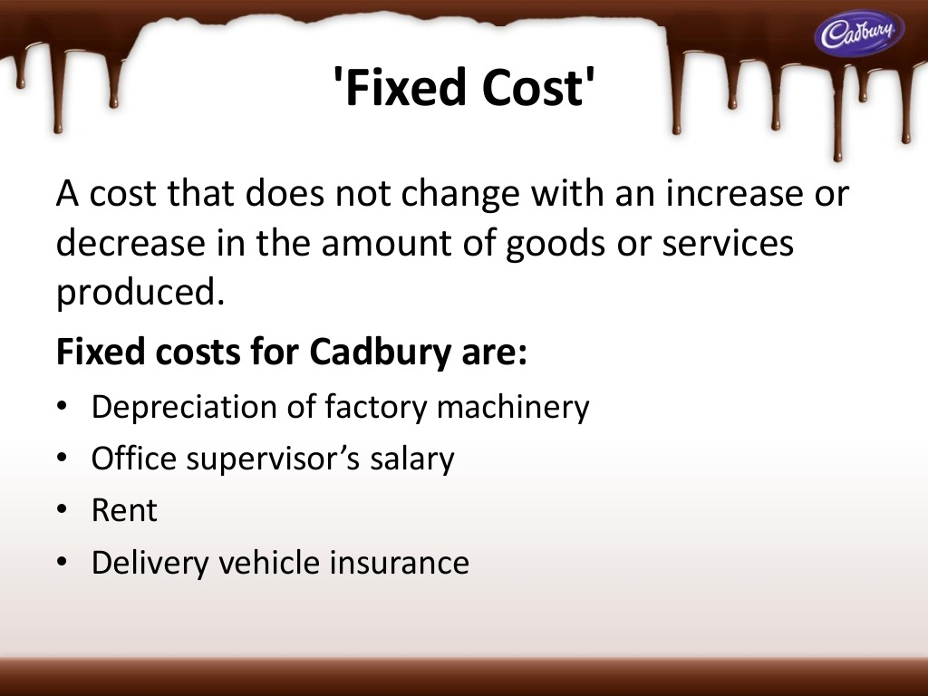

Slide 11
Marketing strategy of Cadbury
Survival
Profit maximization
Growth and diversification
Brand building

Slide 12
Survival
New Products
Keeping up with Innovations in Production
Periodic Budget Analysis
Competitors

Slide 13
Profit Maximization
Increase in Price
Cost Reduction
Marketing Strategies

Slide 14
Growth and Diversification
Affordability and availability.
Advertising aimed at changing consumer perception and eating habits.
Diversification in products.

Slide 15

Brand Building

Slide 16
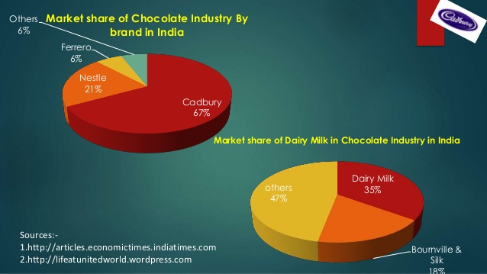
Market Share

Slide 17
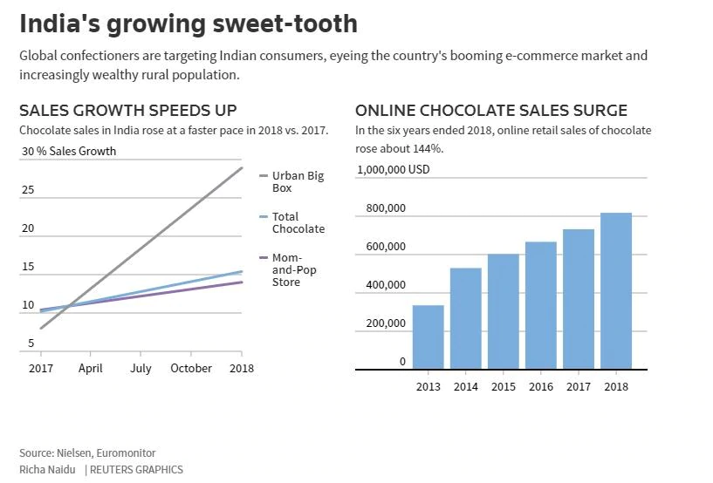
Recent Sales

Slide 18
Group Members
1. Aarya Varat Joshi - 1801CS01
2. Abhijeet Khandwe - 1801CS02
3. Aman Gupta - 1801CS05
4. Anirban Nandi - 1801CS09
5. Mangesh Chandrawanshi - 1801CS16
6. Devanshu Raj - 1801CS19
7. Harsh Gupta - 1801CS21
8. Sriyans Kumar - 1801CS52
9. Vaibhav Goel - 1801EE57
10. Deepansh Gupta - 1801CE07

Slide 19
Special thanks to Dr. Nalin Bharti and
Dr. Rajendra for
this wonderful opportunity to present ourselves.

